Slide 1
“EFFICIENT PUBLIC TRANSPORTATION WITH IOT ENABLED SMART BUS TRACKING AND CROWD MONITORING SYSTEM”
Team members :
311521106074 Priya B
311521106077 Reshmitha R
311521106099 Subbulakshmi G
Guide name :
Mrs . K. Sasikala M.E.,
Asst.Prof / ECE

Slide 2
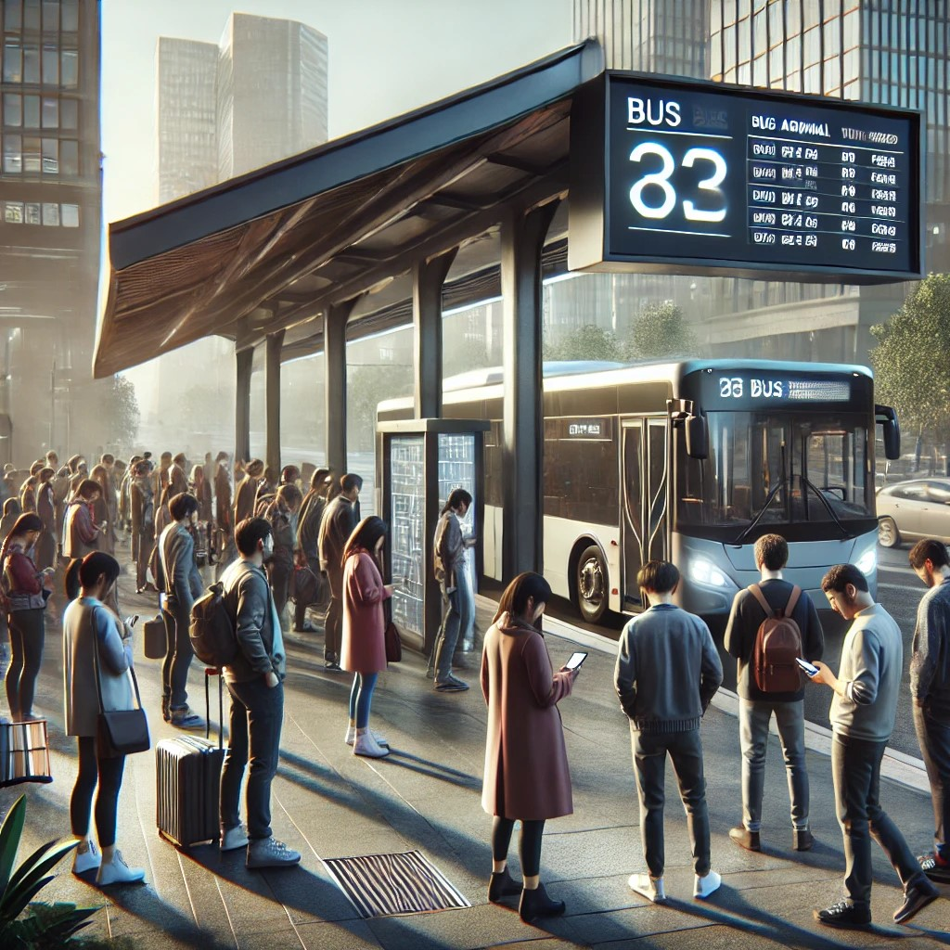
INTRODUCTION
Uses RF, image processing, and wireless modules — no smartphone needed.
Real-time bus ETA & crowd info shown on public LED screens.
Helps elderly, children & those without digital access.
Enhances comfort, safety, and trust in public transport.
Reduces waiting time and improves travel planning.

Slide 3
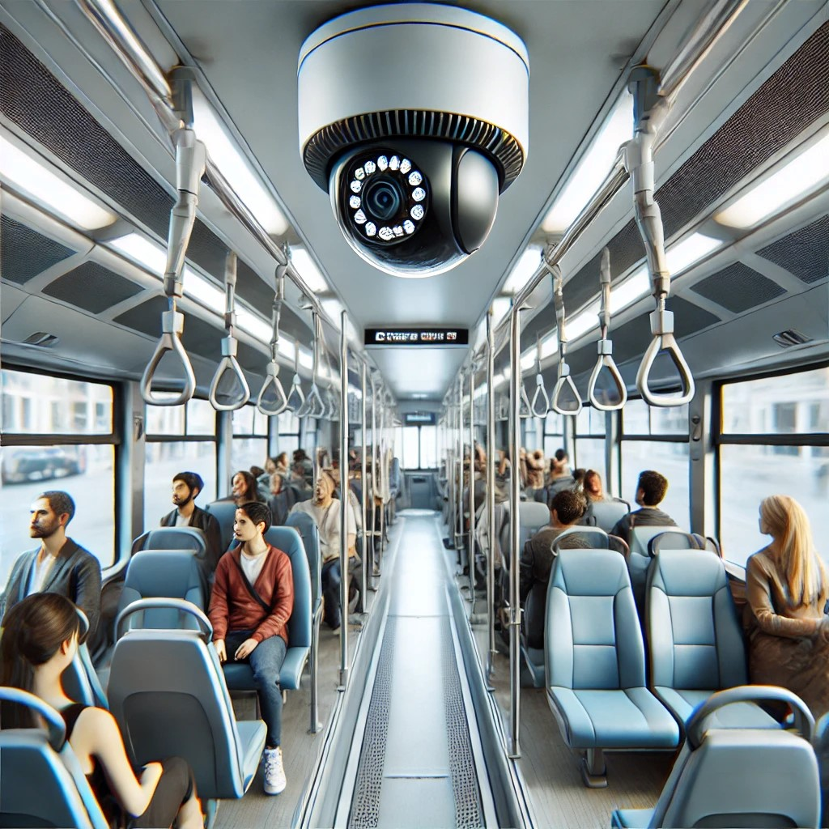
SYSTEM OVERVIEW
Includes microcontroller, RF modules, camera, ESP8266, and LCD display.
Camera + MATLAB = Real-time passenger counting.
ESP8266 sends data to central server for remote monitoring.
RF module tracks bus location accurately.
Enables better scheduling, less congestion, and real-time updates.

Slide 4
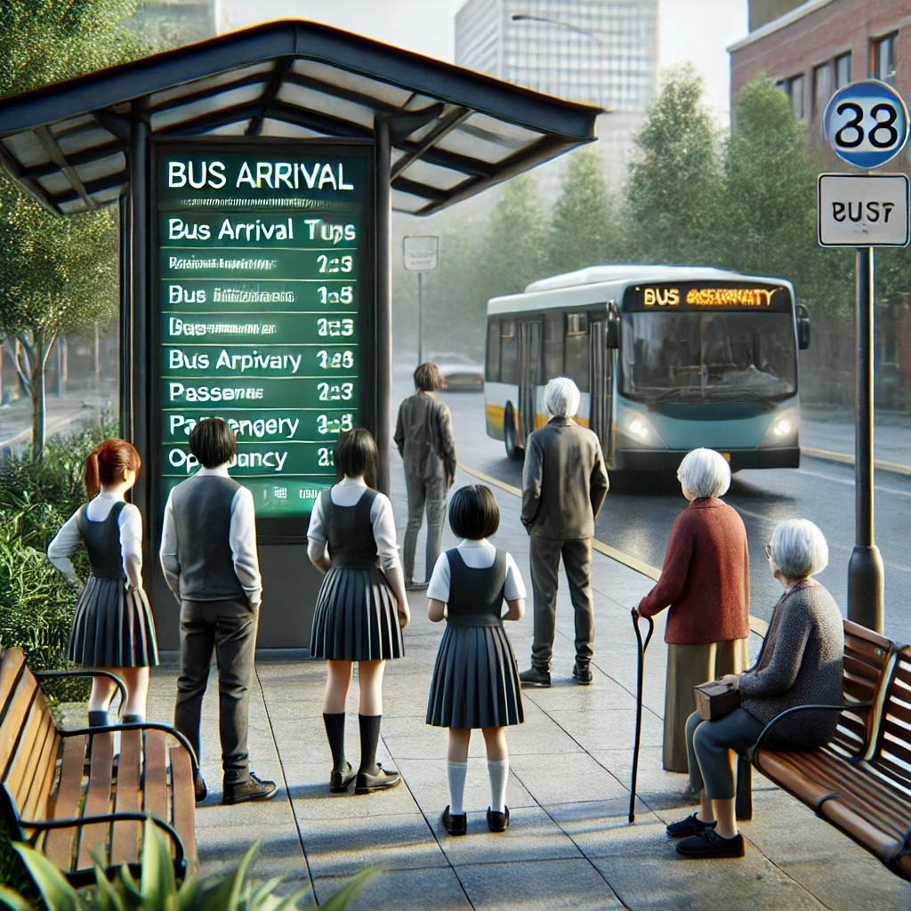
OBJECTIVE
To implement an RF-based system for real-time bus location tracking updates for passengers.
To utilize camera modules and image processing techniques to analyze and display crowd levels inside the bus.
To display bus number, ETA(estimated time arrival), and crowd density at bus stops.
To empower passengers with timely information to avoid overcrowded buses and plan their journeys efficiently.
To make informed decisions, efficient route planning and promoting a smoother, safer travel experience.

Slide 5
LITERATURE SURVEY
SNO | TITLE / AUTHOR | JOURNAL NAME / YEAR | METHODS / PROCESS | RESULT | ADVANTAGES | LIMITATIONS
01
Revolutionizing
Bus Tracking and Arrival Prediction in Real Time for Both Public and Private Sectors, Powered by Firebase
12 June 2024
IEEE
GPS-Based Real-Time Bus Tracking
Historical Data and Route Analysis
Real-Time Traffic and Environmental Data Integration
Machine Learning for Dynamic ETA Prediction
User Feedback and Crowd-sourced Data
Cloud-Based Database Management
Accurate Real-Time ETA Predictions
Dynamic Adjustments Based on Traffic Conditions
High Passenger Satisfaction
Optimized Bus Operations
Scalable System
Predictive Insights for Future Operations
Real-Time Notifications
Accurate real-time ETAs
Improved passenger satisfaction
Optimized bus operations
Scalability and flexibility
Enhanced safety
Predictive insights
Dependency on GPS Accuracy
Traffic Data Integration Challenges
Scalability Challenges
Data Processing Latency
Limited Crowd Monitoring Scope
Machine Learning Model Limitations

Slide 6
LITERATURE SURVEY
SNO | TITLE / AUTHOR | JOURNAL NAME / YEAR | METHODS / PROCESS | RESULT | ADVANTAGES | LIMITATIONS
02
CrowdSurge: A Crowd Density Monitoring
Solution Using Smart Video Surveillance with
Security Vulnerability Assessment
2 April 2022
IEEE
YOLOv4 Object Detection
Web and Mobile Applications for Monitoring
Crowd Density Calculation
Security Vulnerability Testing (OWASP ZAP)
Usability Testing (System Usability Scale - SUS)
Model Evaluation using Confusion Matrix
Detection Accuracy and Performance (YOLOv4 Object Detection)
Accuracy (91.81%) and precision (94.44%)
Crowd Density Estimation
Security Vulnerability Assessment
Usability Testing
Real-Time Monitoring and Alerts
Real-Time, Accurate Crowd Monitoring
High Detection Accuracy and Precision
Effective Crowd Management
Scalability for Public Spaces
Proactive Alerts for Safety
Improved Resource Allocation
Detection Issues with Full Occlusions
Environmental Sensitivity
Dependence on Camera Quality
Limited Scalability

Slide 7
LITERATURE SURVEY
SNO | TITLE / AUTHOR | JOURNAL NAME / YEAR | METHODS / PROCESS | RESULT | ADVANTAGES | LIMITATIONS
03
Bus Tracking System Using RF Communication for Passenger Information over Internet of Things
15 June 2022
IJRASET
GPS Data Collection (Bus Location Tracking)
RF Communication (Data Transmission)
Data Transmission to the Cloud (IoT Integration)
Data Processing and Estimation of Bus ETA
Data Processing & Display
System Testing and Validation
Accuracy of the bus location was validated with an error margin of ±10-15 meters.
Average ETA accuracy was within ±3 minutes
Data transmission delay was minimal, with updates sent approximately every 1-2 seconds
Successful data storage and real-time accessibility.
Real-Time Bus Location Tracking
Efficient RF Communication
Enhanced Passenger Satisfaction
Improved Safety
Increased Operational Efficiency
Cost-Efficiency
Cloud-Based Data Storage and Access
Weather Conditions Impact
System Maintenance and Calibration
Passenger Engagement with Technology
Maintenance of Communication Infrastructure

Slide 8
PROBLEM STATEMENT
Uncertainty in Bus Arrival Times: Passengers are left guessing when their bus will arrive, resulting in long waiting times and inefficient travel planning.
Overcrowding at Bus Stops and Buses: Without real-time crowd density information, passengers may arrive at already crowded bus stops or board overcrowded buses, leading to discomfort and delays.
Fragmented Information Systems: There is no integrated platform that provides both bus tracking and crowd monitoring, leaving passengers without comprehensive, real-time information.
Unaware of the new apps : The existing apps are not fully utilized by the people of all ages.

Slide 9
METHODOLOGY
Step 1: Image Acquisition and Preprocessing
A camera inside the bus captures images of passengers at regular intervals.
The acquired images undergo preprocessing in MATLAB, including gray scale conversion and noise reduction using a Gaussian filter to enhance detection accuracy.
Step 2: Passenger Detection and Counting
The system applies face detection algorithms like Haar Cascade or Histogram of Oriented Gradients (HOG) to identify passengers.
Edge detection (Sobel/Canny) and blob detection techniques refine the results.
Connected component analysis is used to count the number of detected passengers.
Step 3: Real-Time Bus Location Tracking
A RF Transmitter (Tx) and Receiver (Rx) module track the bus location. The microcontroller (ATmega328) processes the RF signals and updates the real-time bus location.

Slide 10
METHODOLOGY
Step 4: Data Processing and Wireless Transmission
The microcontroller processes the passenger count and location data and transmits it using the ESP8266 Wi-Fi module.
This data is sent to a cloud server, allowing remote access by transport authorities and bus stand display units.
Step 5: Bus Stand Display System
At the bus stand, an LCD/LED screen receives real-time data updates via the RF or Wi-Fi network.
The display shows bus arrival times, current location, and passenger occupancy, helping commuters plan their travel efficiently.
Step 6: Remote Monitoring via Web Applications
Passengers and transport operators can access real-time bus status and crowd levels through a web or mobile application.
This helps in efficient bus scheduling, reducing wait times, and improving public transport management.

Slide 11

FLOW DIAGRAM
Threshold level in prototype
Count=1 (Very Low crowd).
Count=2 (Low crowd).
Count=3 (Moderate crowd).
Count=4 (High crowd).
Algorithm for Passenger Counting
Step 1: Image Acquisition
Step 2: Preprocessing
Step 3: Face Detection and Passenger Counting
Step 4: Data Transmission to Microcontroller
Step 5: Wireless Data Transmission to Bus Stand
Step 6: Display at Bus Stand and Remote Access

Slide 12
FLOW DIAGRAM
Algorithm for Estimation time of arrival
Step 1: Bus Begins Route
Step 2: Bus Approaches a Bus Stop
Step 3: Bus Detected at a Stop
Step 4: Data Sent to Central Server
Step 5: Server Logs Detection
Step 6: ETA Calculation
Step 7: ETA Broadcast

Slide 13
BLOCK DIAGRAM
CAMERA
TRANSMITTER SIDE
RECEIVER SIDE
ARDUINO
LCD DISPLAY
PEOPLE COUNT
RADIO FREQUENCY TRANSMITTER
RADIO FREQUENCY RECEIVER
ARDUINO
MICRO CONTROLLER
ESP8266
CLOUD SERVER
SETUP INSIDE THE BUS
SETUP IN THE BUS STOP

Slide 14
Importance of Esp8266
Key Points for Efficient Bus Scheduling
Identifies Peak Hours – Helps in detecting high-demand time slots to increase bus frequency.
Route Load Balancing – Enables redistribution of buses from underutilized to overcrowded routes.
Reduces Waiting Time – Prevents delays by avoiding overloading and optimizing dispatch times.
Improves Passenger Comfort – Ensures passengers aren’t forced into crowded buses, encouraging public transport usage.
Supports Dynamic Scheduling – Real-time crowd data allows authorities to adjust schedules on-the-fly.
Data-Driven Planning – Helps in long-term scheduling decisions based on crowd trends and patterns.

Slide 15
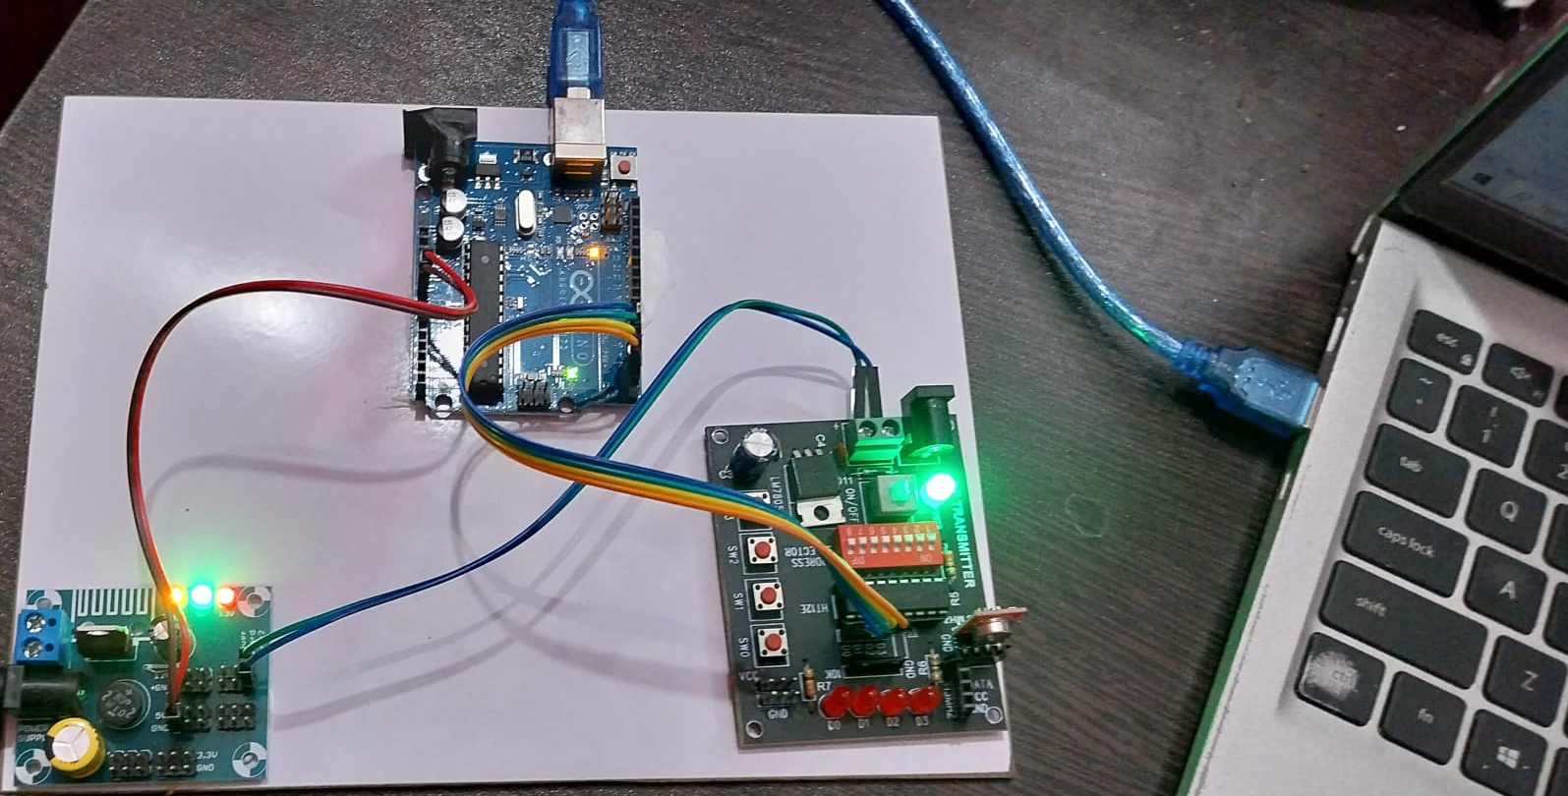
TRANSMITTER SETUP
CAMERA
ARDUINO UNO
POWER SUPPLY
RF TRANSMITTER

Slide 16
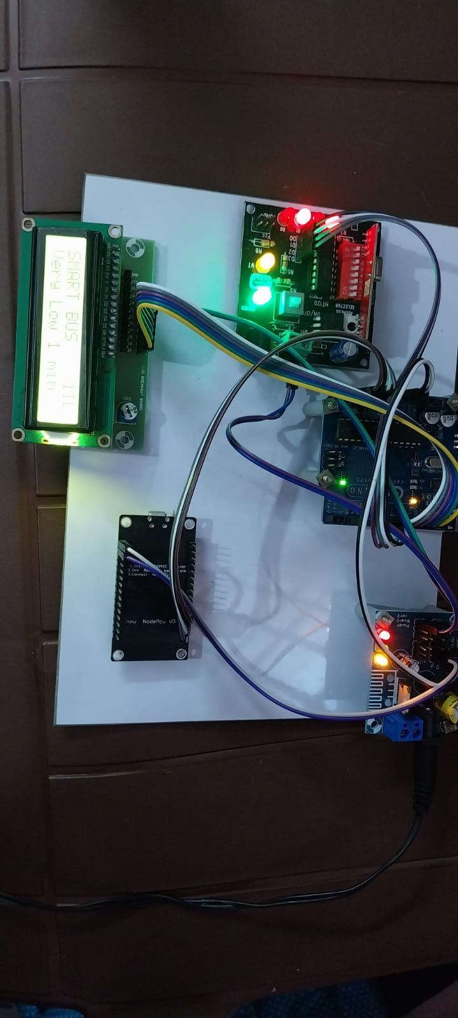
RECEIVER SETUP
RF RECEIVER
POWER SUPPLY
ARDUINO UNO
ESP8266
LCD DISPLAY

Slide 17
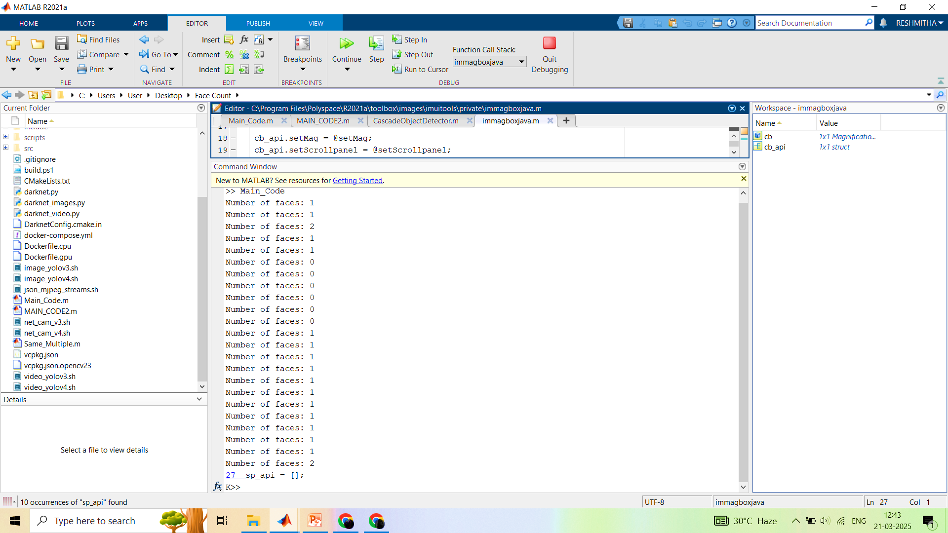
SIMULATION OUTPUT

Slide 18
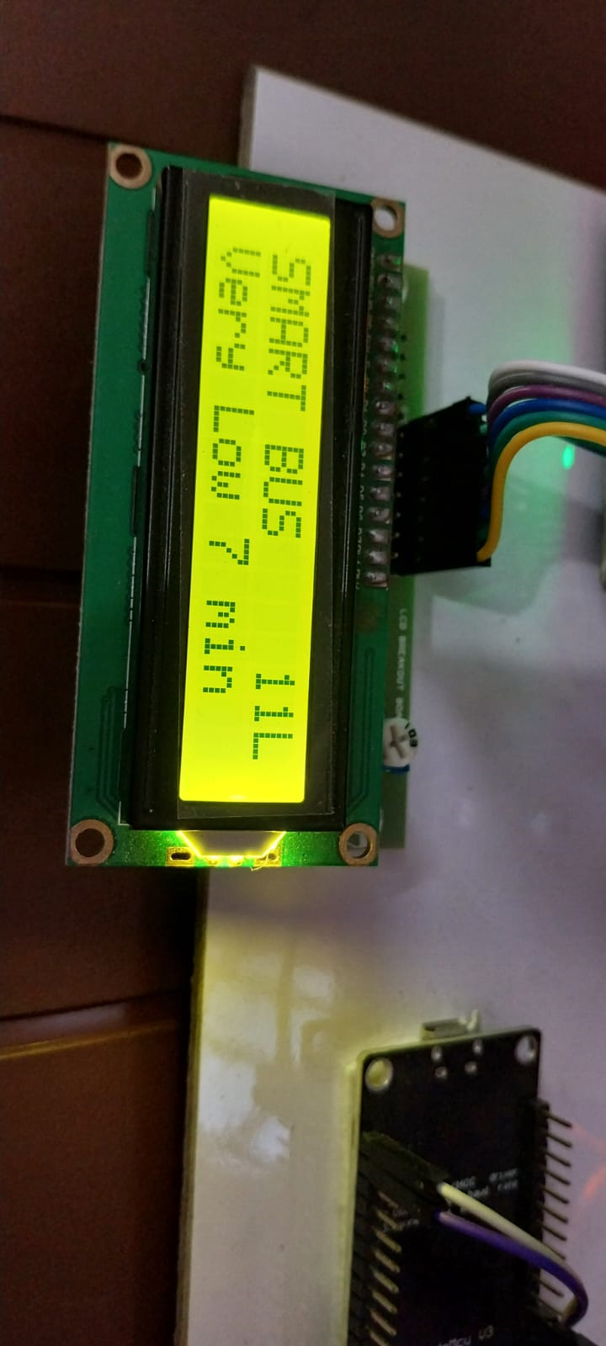
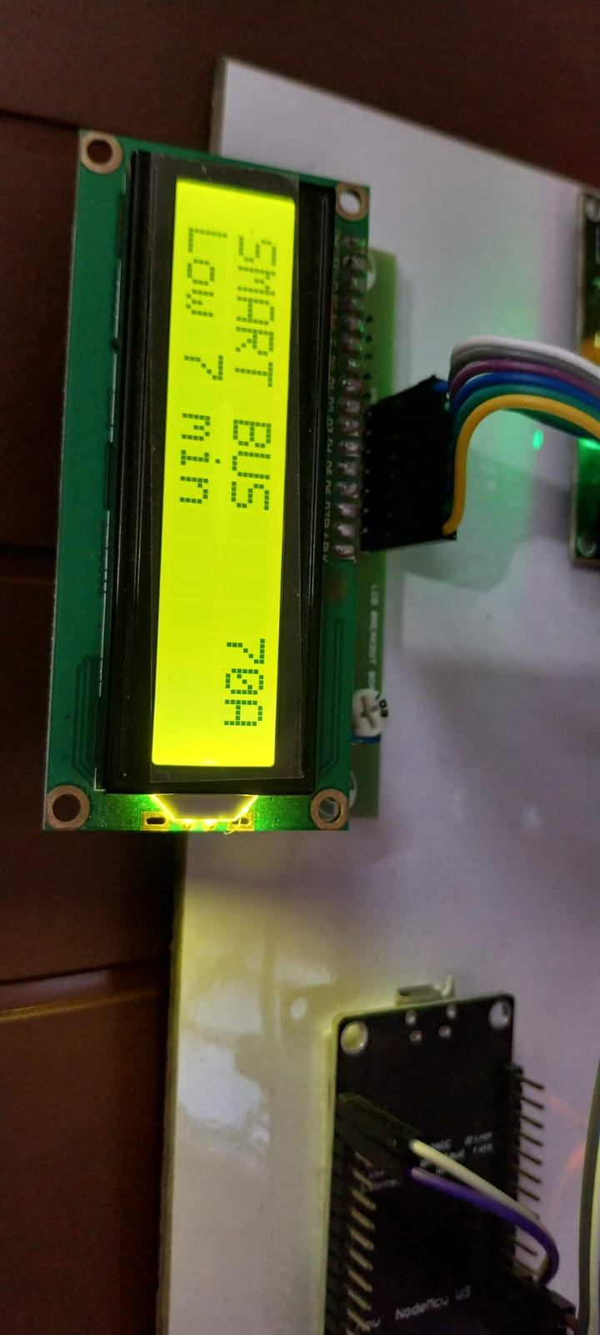
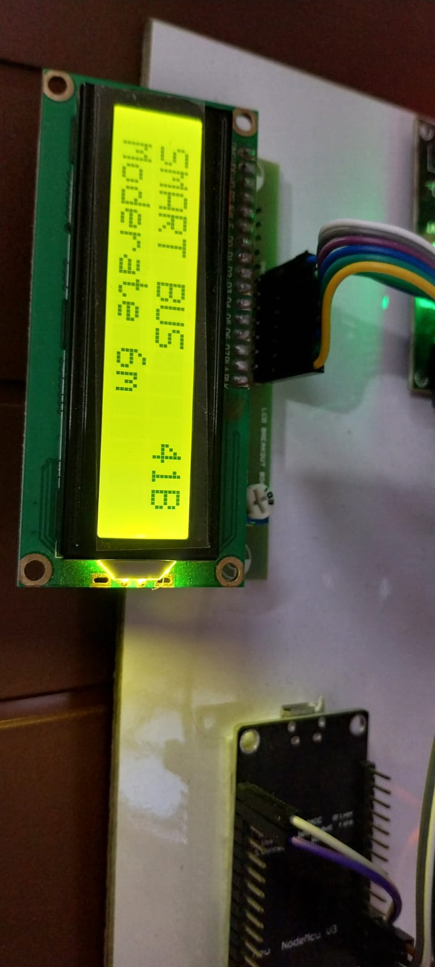
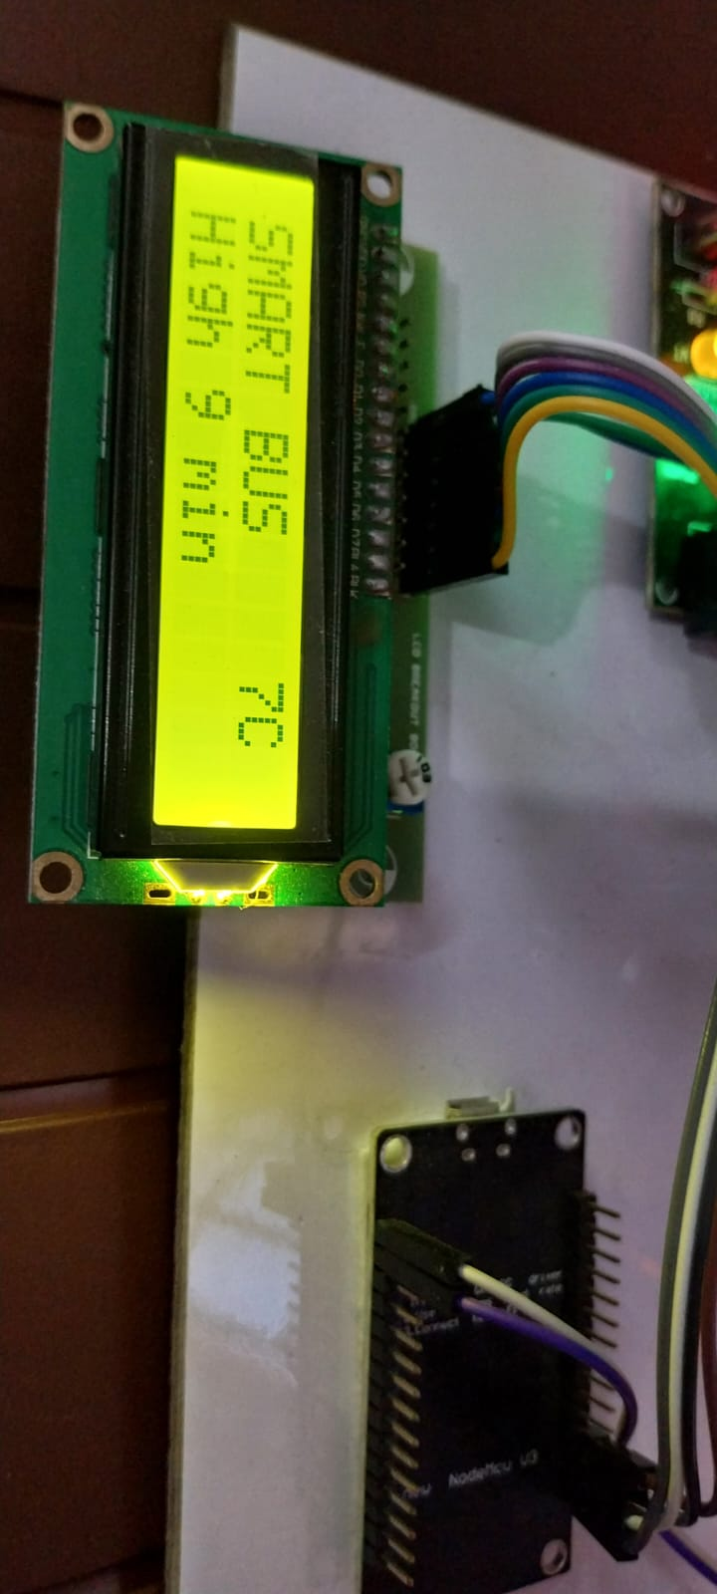
RESULTS
Bus no. 11
Count=1 = Very Low
ETA = 7min
Ladies free bus=“L”
Bus no. 70A
Count=2= Low
ETA = 7 min
Bus no. 41B
Count=3 = Moderate
ETA = 6 min
Bus no. 7C
Count>4 = High
ETA = 9 min

Slide 19
RESULTS
Real-Time Information : Passengers will receive accurate updates on bus arrival times and crowd levels at bus stops.
Reduced Overcrowding : The system will help distribute passengers more evenly across buses, minimizing overcrowding.
Optimized Bus Operations : Transport authorities can adjust bus routes and schedules based on real-time crowd data, improving service efficiency.
Accessibility to all age people : Public transport can be efficiently utilized with comfortable from students to elder peoples.

Slide 20
CONCLUSION
The system provides real-time bus tracking, displaying accurate bus numbers, ETAs, and crowd levels at bus stops.
Crowd management is enhanced by monitoring the density of passengers inside buses to ensure better space allocation.
It optimizes bus routes and schedules based on real-time data, improving the efficiency of the transport system.
The system improves the passenger experience by reducing waiting times and preventing overcrowding with up-to-date information.
Seamless communication between buses, bus stops, and operators ensures fast and efficient data exchange, keeping the system running smoothly.

Slide 21
FUTURE SCOPE
Enhanced Passenger Safety: Real-time tracking enables quick responses to emergencies, improving safety for passengers.
Optimized Route Management: Provides accurate bus location data, helping reduce delays and improve operational efficiency.
Effective Crowd Control: Monitors crowd density at stops, preventing overcrowding and ensuring safer, more comfortable conditions.
Increased Service Reliability: Real-time bus information helps passengers plan better, reducing wait times and improving overall reliability.
Data-Driven Improvements: Collects valuable data for transportation authorities to optimize services and plan for future needs.

Slide 22
REFERENCE
Lee, SeokJu & Tewolde, Girma & Kwon, Jaerock. (2014). Design and implementation of vehicle tracking system using GPS/GSM/GPRS technology and smartphone application. 353-358. 10.1109/WF-IoT.2014.6803187.
Samonte, Mary Jane & Garcia, Andrea & Gorre, Jealine & Perez, Joshua. (2022). CrowdSurge: A Crowd Density Monitoring Solution Using Smart Video Surveillance with Security Vulnerability Assessment. Journal of Advances in Information Technology. 13. 10.12720/jait.13.2.173-180.
M. Shafiulla, A. L. H. P S, S. Mohammed Naveed, S. Ahmed, M. Dhar M and U. Kumar, "Revolutionizing Bus Tracking and Arrival Prediction in Real Time for Both Public and Private Sectors, Powered by Firebase," 2024 Third International Conference on Distributed Computing and Electrical Circuits and Electronics (ICDCECE), Ballari, India, 2024, pp. 1-8, doi: 10.1109/ICDCECE60827.2024.10549731.
Nagaraju, Bagam. (2022). Bus Tracking System Using RF Communication for Passenger Information over Internet of Things. International Journal for Research in Applied Science and Engineering Technology. 10. 2264-2269. 10.22214/ijraset.2022.44285.

Slide 23
THANK YOU

